Slide 1
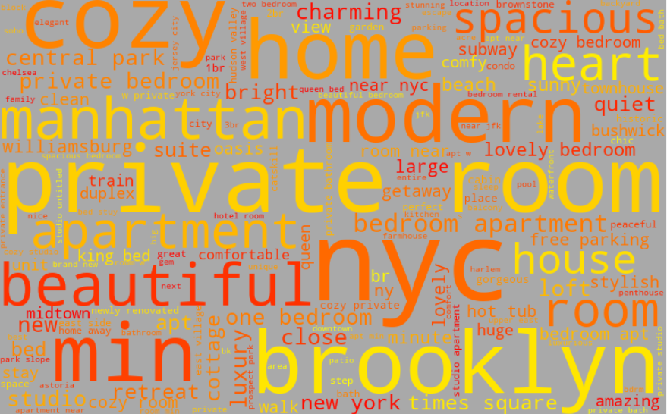
AirBNB: NYC
Data Visualization :
NYC AirBNB Listings
Orie Wyatt
Orie Wyatt

Slide 2
Questions to Answer
1. Which is the most profitable AirBNB rental size per bedroom?
2. What percentages of rentals are owned by owners with multiple listings?
3. What are the top neighborhoods in terms of rental frequency and annual income?

Slide 3
1. Which is the most profitable AirBNB rental size per bedroom?
Average daily rates
Annual Revenue

Slide 4
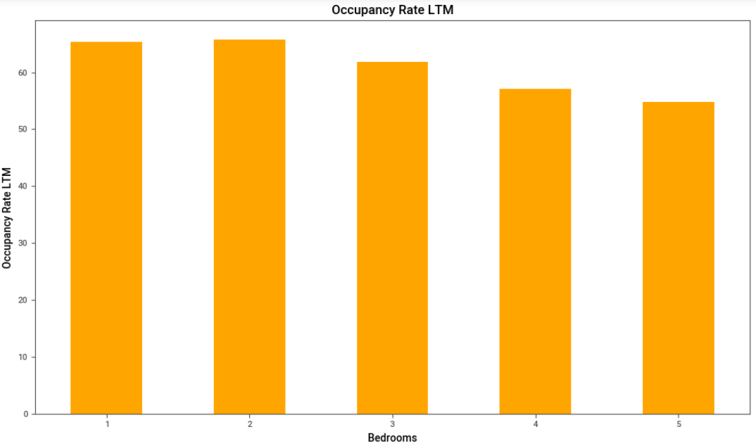
Occupancy Rates

Slide 5
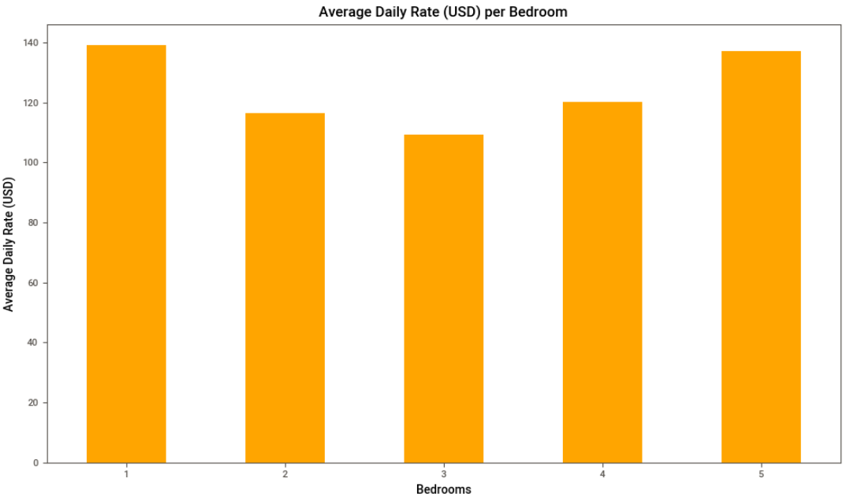
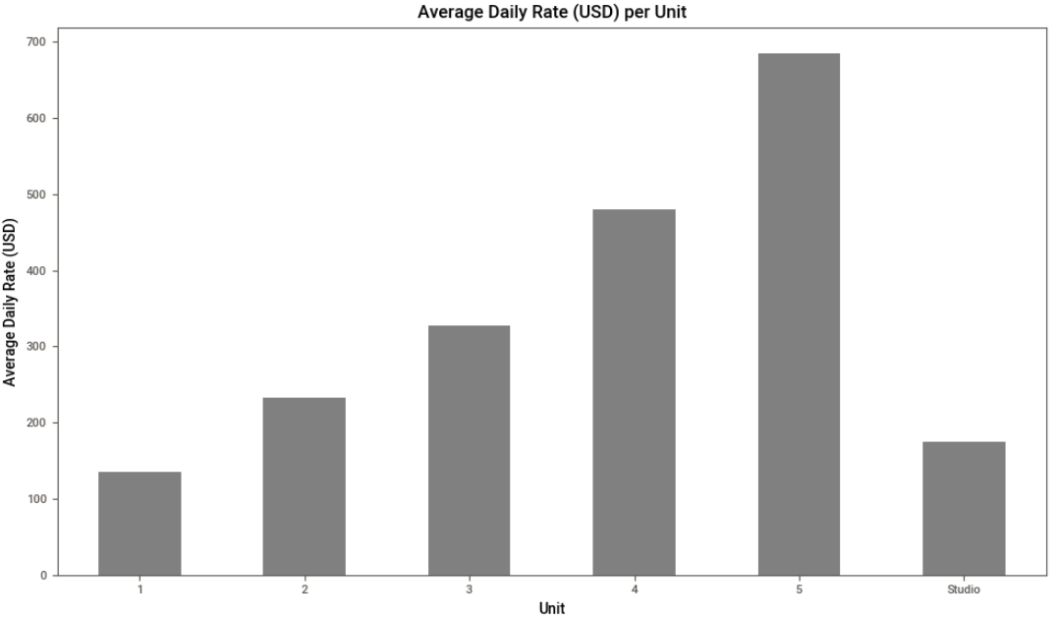
Average daily rates

Slide 6
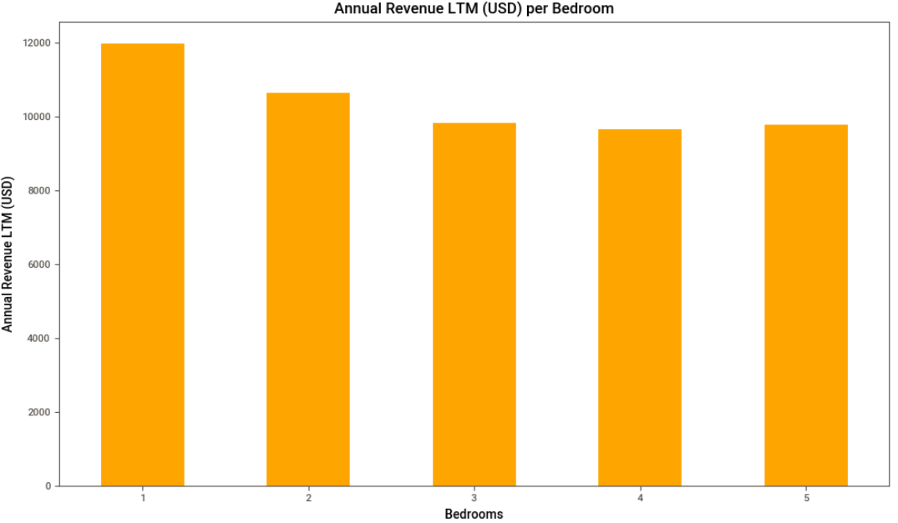
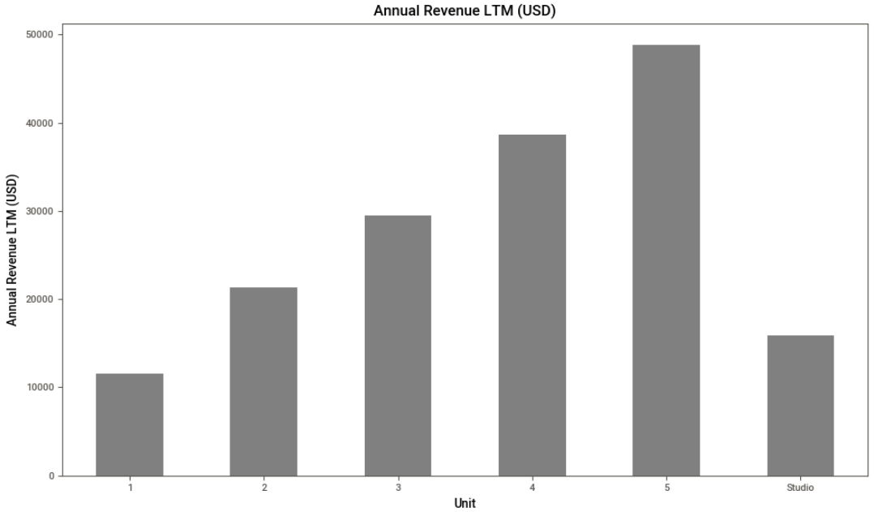
Annual revenue

Slide 7
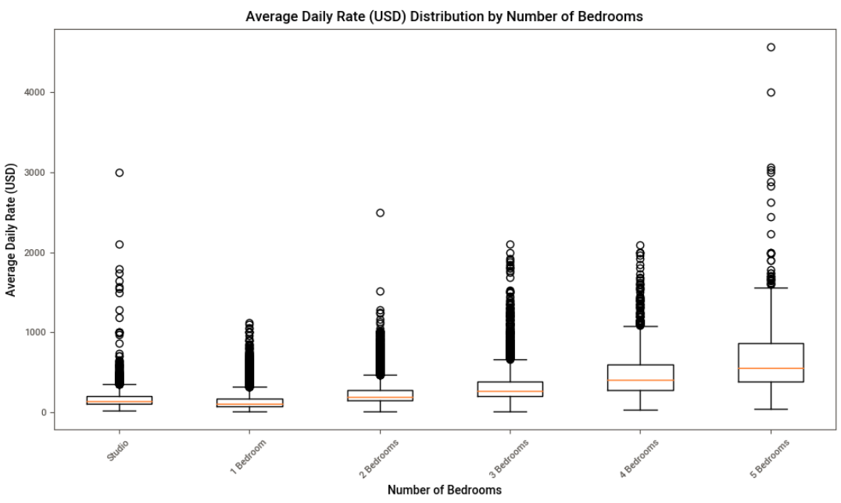

Slide 8
2. What percentages of rentals are owned by owners with multiple listings?
Distribution of # of Properties Owned
Host Types
Annual Revenue

Slide 9
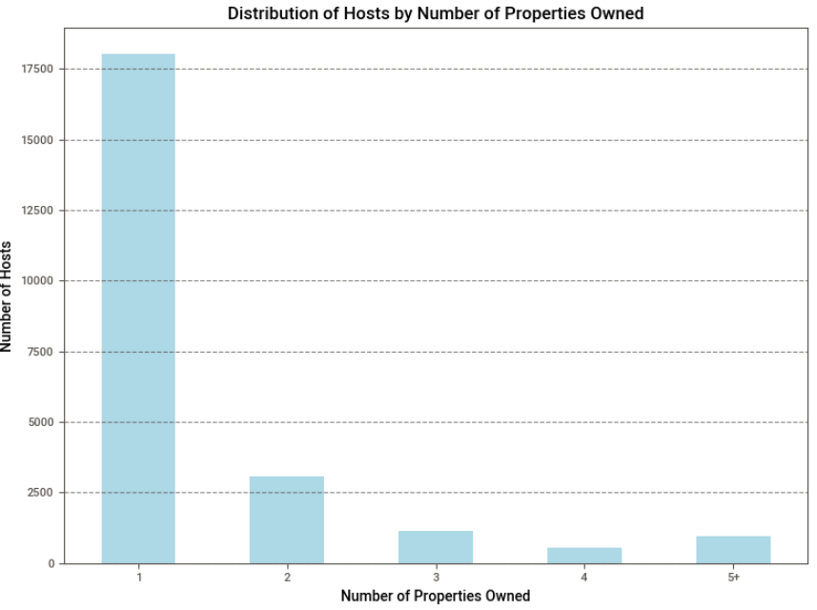

Slide 10
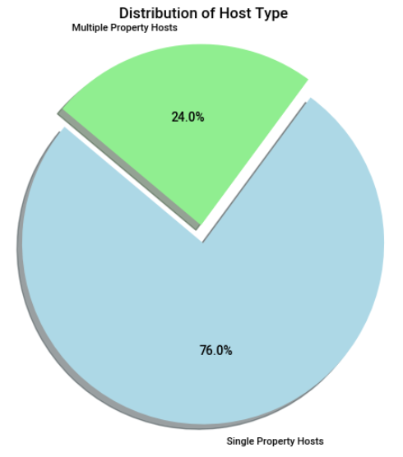
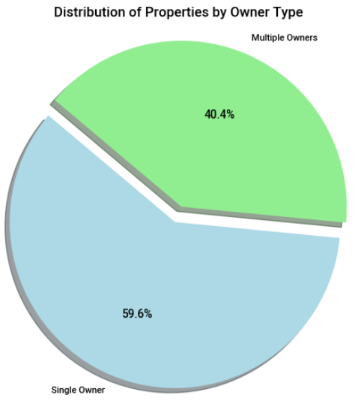

Slide 11
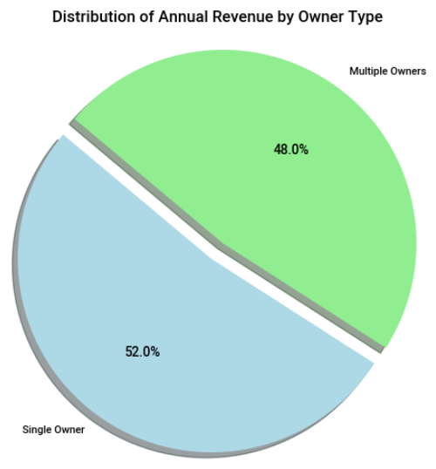
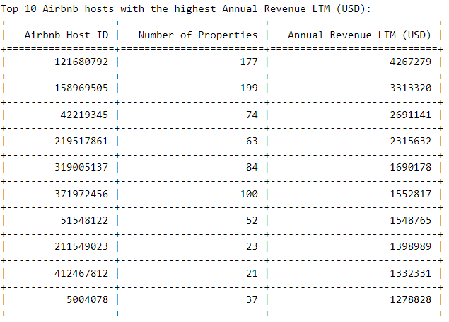

Slide 12
3. What are the top neighborhoods in terms of rental frequency and annual income?
Frequency
Annual Income

Slide 13
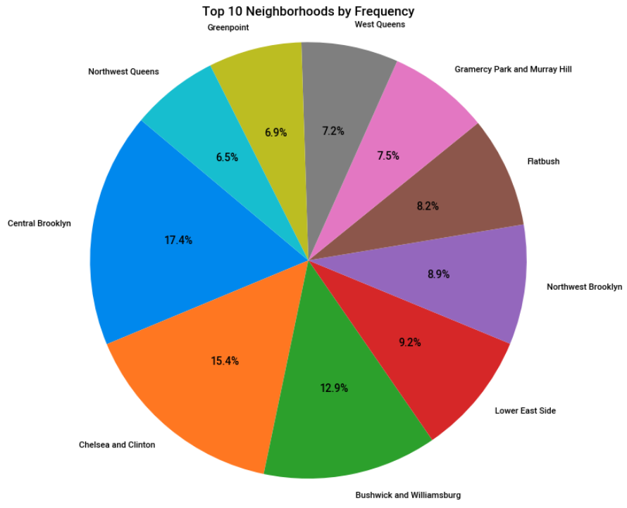

Slide 14
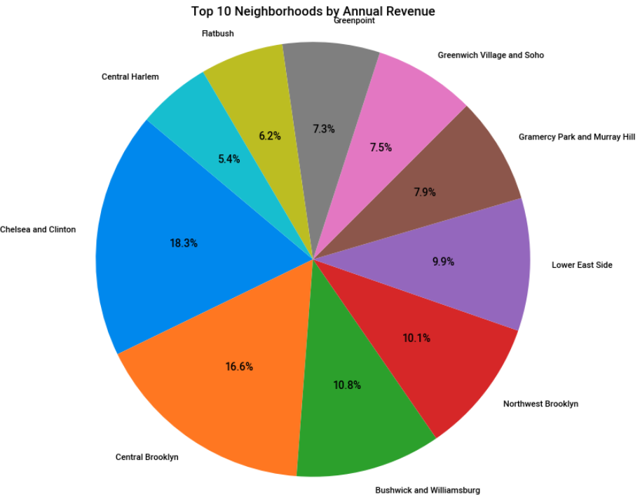

Slide 15
Conclusions
Inverse relation between occupancy and # bedrooms
Higher bedrooms earn more annual summary
Most hosts are single property owners although 40% of properties are owned by individuals owning more than one property. Annual revenue is split almost 50/50
Chelsea and Clinton (Hell’s Kitchen) is the most common rental location and has the largest annual revenue as well.

Slide 16
Future Work
Calculate ROI based on average prices from each neighborhood.
Calculate ROI based on cost per bedroom
Compare to other major AirBNB markets
Source: https://www.kaggle.com/datasets/jaeseokanairbtics/airbnb-data-listings-scraped-global-top-10-cities

